Slide 1

DAY 04
Chapter 9 (Part 1) Pointers
1

Slide 2
Declaring Pointer Variables
Pointers declared like other types
Add "*" before variable name
Produces "pointer to" that type
"*" must be before each variable
int *p1, *p2, v1, v2;
1-2
2

Slide 3
Declaring Pointer Variables
•
type *ptr;
type* ptr, ;
type * ptr;
For example,
int * iPtr;
double * dPtr;
1-3
3

Slide 4
Declaring Pointer Variables
int nancy;
This will put nancy into a vacant house, of type int, somewhere along the street.
Currently, nancy does not have anything stored in her house.
nancy = 25;
This will store the value 25 into nancy 's house.
1-4
4

Slide 5
Computer Memory
HEX not easy
To make it easier, C introduced the concept of variables.
Variable | named location that stores a value of a particular type.
Also, types (such as int, double, char) are associated with the contents for ease of interpretation of data.
5

Slide 6
Computer Memory
int a = 100;
Variable a’s value ?
stored at memory location ?
6

Slide 7
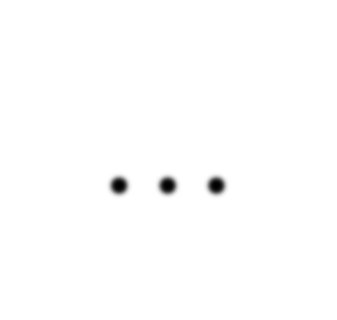

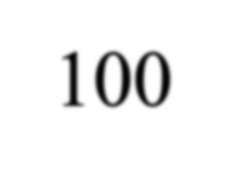
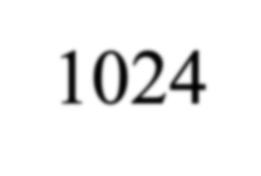
Computer Memory
int a = 100;
Memory address:
1020
1024
1032
… | … | 100 | … | 1024 | …
a
Variable a’s value, i.e., 100, is stored at memory location 1024
7

Slide 8


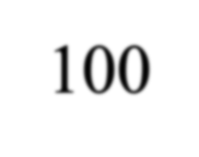
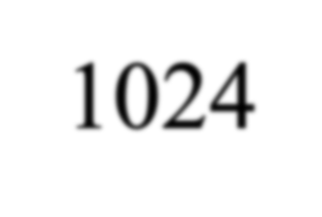
Pointers
Memory address:
1020
1024
1032
…
…
100
…
1024
…
integer
pointer
8

Slide 9
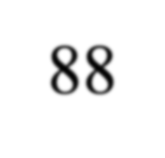
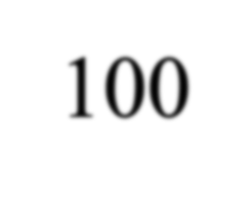
Address Operator &
Memory address:
1020
1024
1032
…
88
100
…
…
…
a
#include <iostream>
using namespace std; void main(){
int a, b; a = 88;
b = 100;
b
cout << "The | address | of a is: | " << | &a | << endl;
cout << "The | address | of b is: | " << | &b | << endl;
}

Slide 10
Address Operator &
Memory address:
1020
1024
1032
…
88
100
…
…
…
a
#include <iostream>
using namespace std; void main(){
int a, b; a = 88;
b = 100;
b
Result is:
The address of a is: 1020 The address of b is: 1024
cout << "The | address | of a is: | " << | &a << endl;
cout << "The | address | of b is: | " << | &b << endl;
}

Slide 11
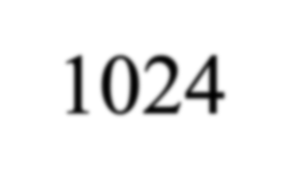
Pointer Variables
Memory address:
1020
1024
1032
… | 88 | 100 | … | 1024 | …
a
p
int a = 100; int *p = &a;
cout << a << " " << &a <<endl; cout << p << " " << &p <<endl;
• The value of pointer p is the address of variable a
• A pointer is also a variable, so it has its own memory address

Slide 12
Pointer Variables
Memory address:
1020
1024
1032
… | 88 | 100 | … | 1024 | …
a
p
int a = 100; int *p = &a;
cout << a << " " << &a <<endl; cout << p << " " << &p <<endl;
Result is:
100 1024
1024 1032
• The value of pointer p is the address of variable a
• A pointer is also a variable, so it has its own memory address

Slide 13
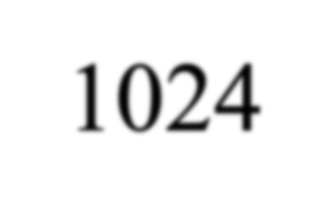
Dereferencing Operator *
We can access to the value stored in the variable pointed to by using the dereferencing operator (*),
Memory address:
1020
1024
1032
… | 88 | 100 | … | 1024 | …
int a = 100; int *p = &a;
cout << a << endl; cout << &a << endl;
a
p
cout | << | p << " " << | *p << | endl;
cout | << | &p << endl;

Slide 14
Dereferencing Operator *
We can access to the value stored in the variable pointed to by using the dereferencing operator (*),
Memory address:
1020
1024
1032
… | 88 | 100 | … | 1024 | …
int a = 100; int *p = &a;
cout << a << endl; cout << &a << endl;
a
p
Result is:
100
1024
1024 100
1032
cout | << | p << " " << | *p << | endl;
cout | << | &p << endl;

Slide 15
Don’t get confused
Declaring a pointer means only that it is a pointer: int *p;
Don’t be confused with the dereferencing operator, which is also written with an asterisk (*). They are simply two different tasks represented with the same sign
int a = 100, b = 88, c = 8; int *p1 = &a, *p2, *p3 = &c;
p2 = &b; p2 = p1; b = *p3;
*p2 = *p3;
// p2 points to b
// p2 points to a
//assign c to b
//assign c to a
cout << a << b << c;

Slide 16
Don’t get confused
Declaring a pointer means only that it is a pointer: int *p;
Don’t be confused with the dereferencing operator, which is also written with an asterisk (*). They are simply two different tasks represented with the same sign
*, operates on a pointer variable. It returns the location value in memory pointed to by the variable's value.
int x; int *p;
Here, the asterisk tells the compiler, "p is not an integer, but rather a pointer to a location in memory which holds an integer." Here, it is not a dereference, but part of a pointer declaration.
p = &x;
This action tells the compiler, "The address in memory that p points to is the address that you allocated for the integer x."

Slide 17
Don’t get confused
Declaring a pointer means only that it is a pointer: int *p;
Don’t be confused with the dereferencing operator, which is also written with an asterisk (*). They are simply two different tasks represented with the same sign
int a = 100, b = 88, c = 8; int *p1 = &a, *p2, *p3 = &c;
p2 = &b; | // p2 points | to | b
p2 = p1; | // p2 points | to | a
b = *p3;
*p2 = *p3;
//assign c to b
//assign c to a
Result is:
888
cout << a << b << c;

Slide 18
Pointing to …
int *p1, *p2, v1, v2;
p1 = &v1;
Sets pointer variable p1 to "point to" int variable v1
Operator, &
Determines "address of" variable
1-18

Slide 19
Pointing to …
Recall:
int *p1, *p2, v1, v2;
p1 = &v1;
Two ways to refer to v1 now:
Variable v1 itself:
cout << v1;
Via pointer p1: cout *p1;
•
p1=&v1 – p1 points to v1
1-19

Slide 20
"Pointing to" Example
Consider:
v1 = 0;
p1 = &v1;
*p1 = 42;
cout << v1 << endl; cout << *p1 << endl;
What is the output?
1-20

Slide 21
Pointer Assignments
What is the difference between
int *p1, *p2; p2 = p1;
And
int *p1, *p2;
*p1 = *p2;
1-21

